Slide 1
AI for Music Intelligence: Lyrical Evolution and Thematic Profiling - Streamlit Dashboard
Tanya Gupta tanya5 CS410 Semester Project Presentation

Slide 2
Demo of Project Usage (in video)
Link to Video: https://mediaspace.illinois.edu/media/t/1_mrqfw7f3

Slide 3
Below is music_intelligence_analysis.py walkthrough

Slide 4

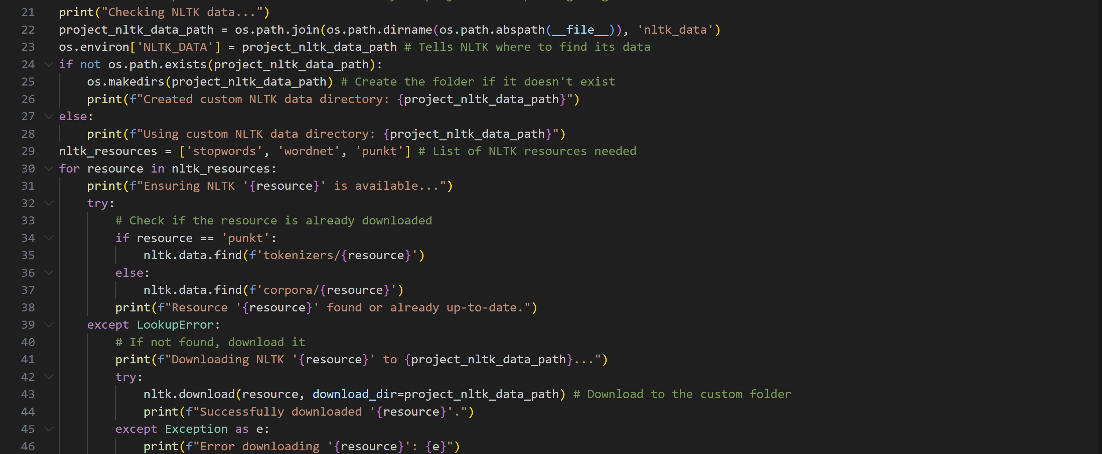
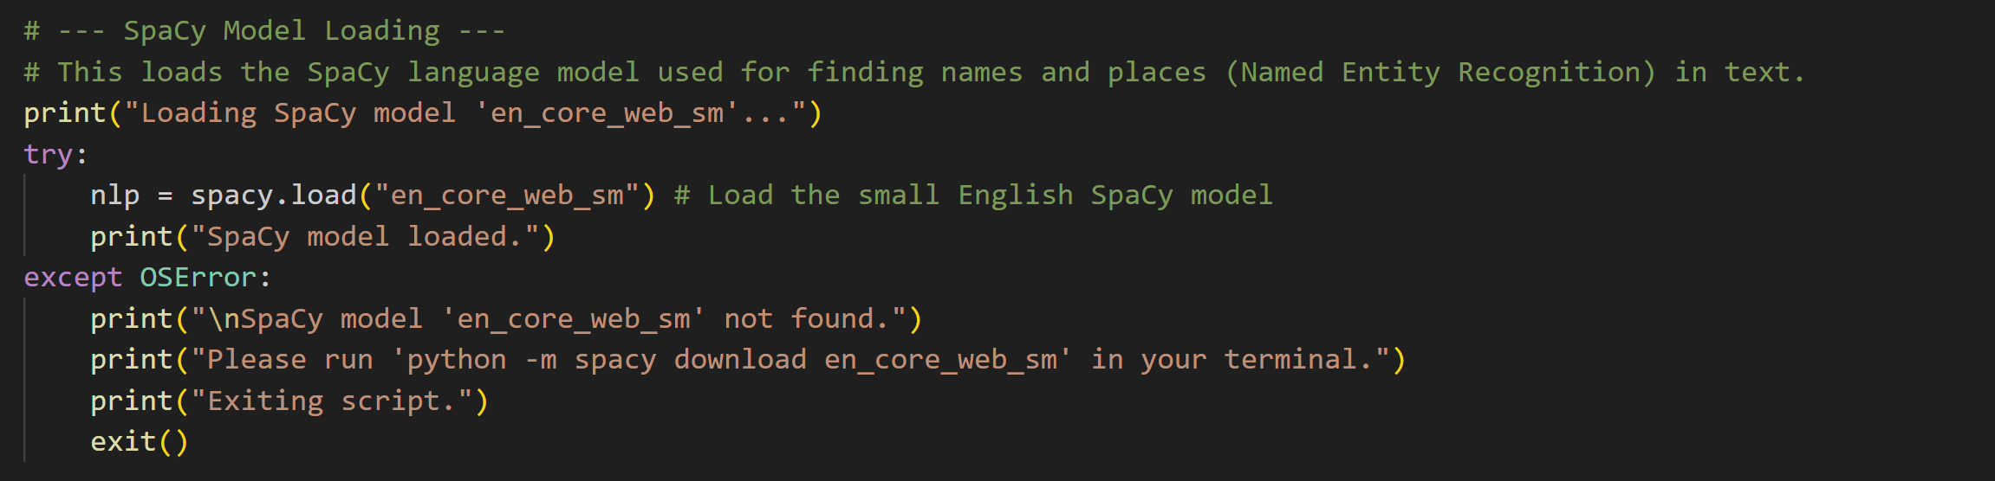
Dependencies and Environment Setup

Slide 5
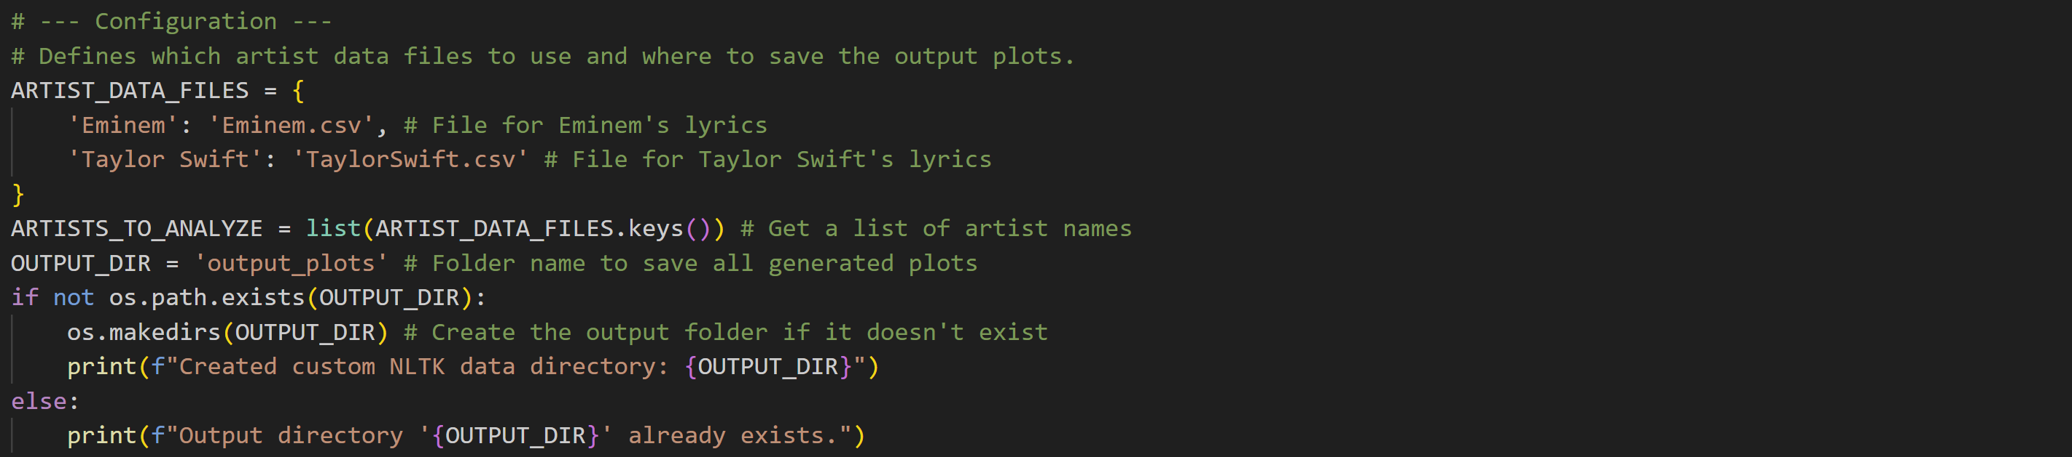
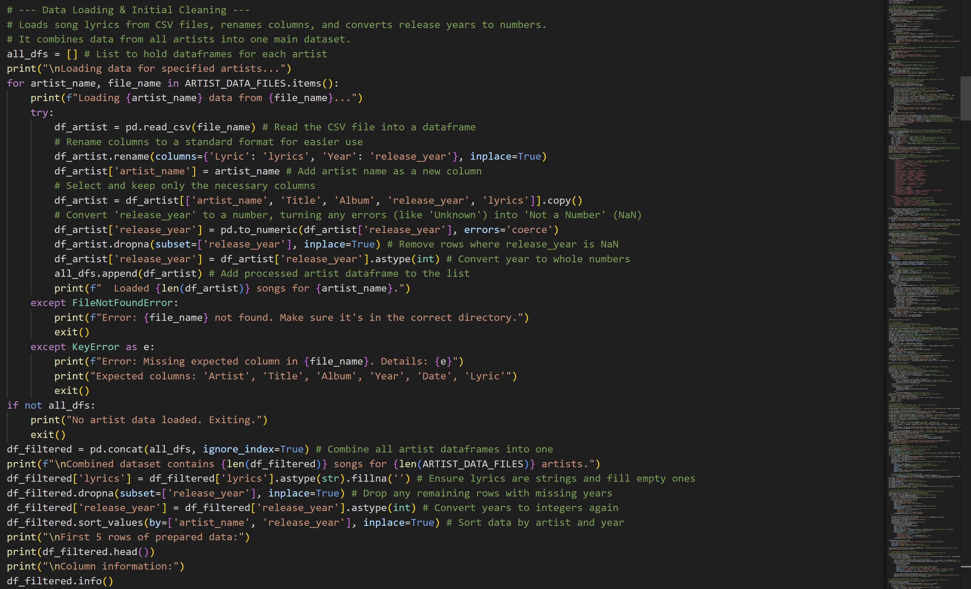
Configuration and Data Ingestion

Slide 6
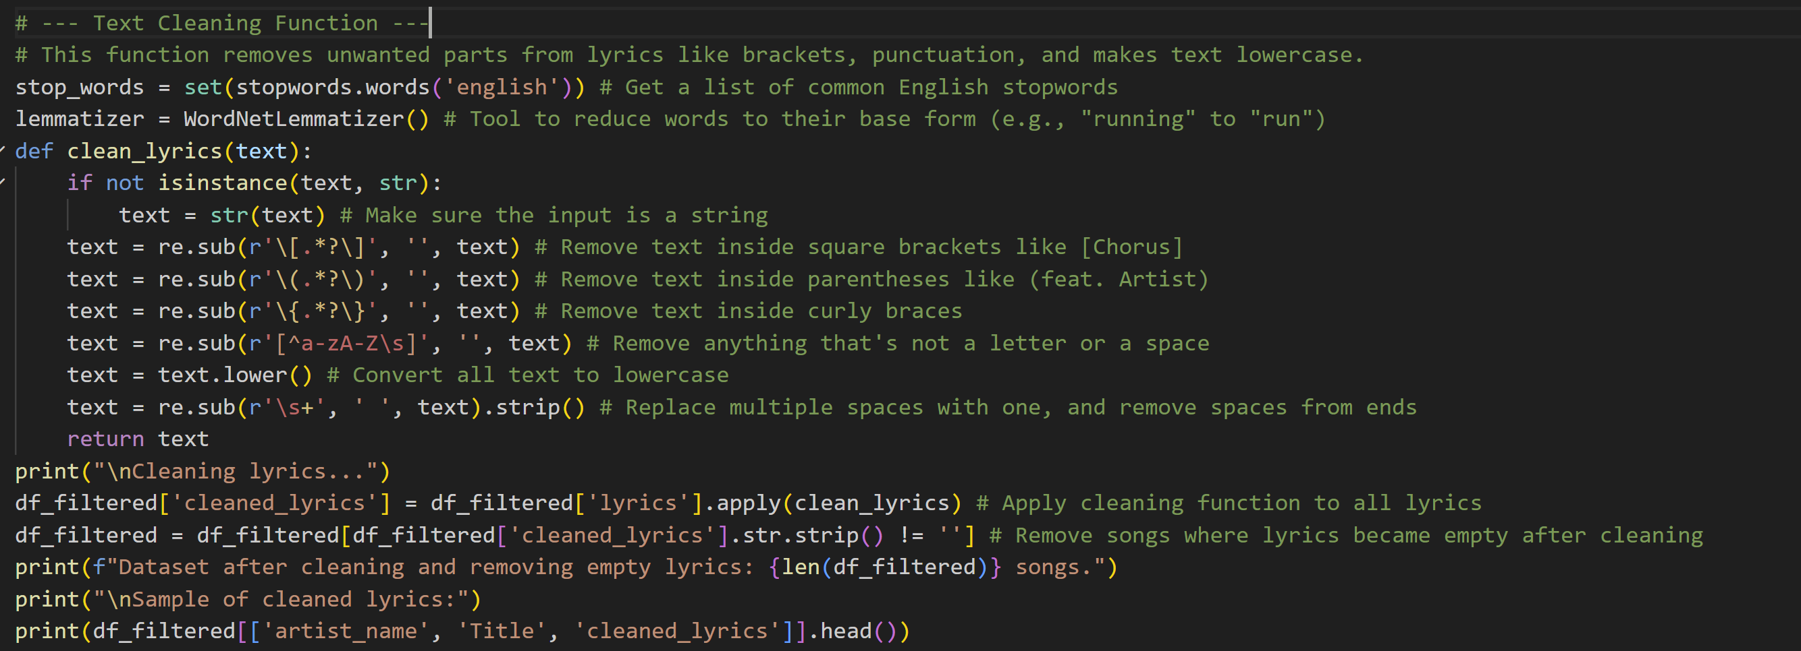
Core Text Preprocessing Function

Slide 7
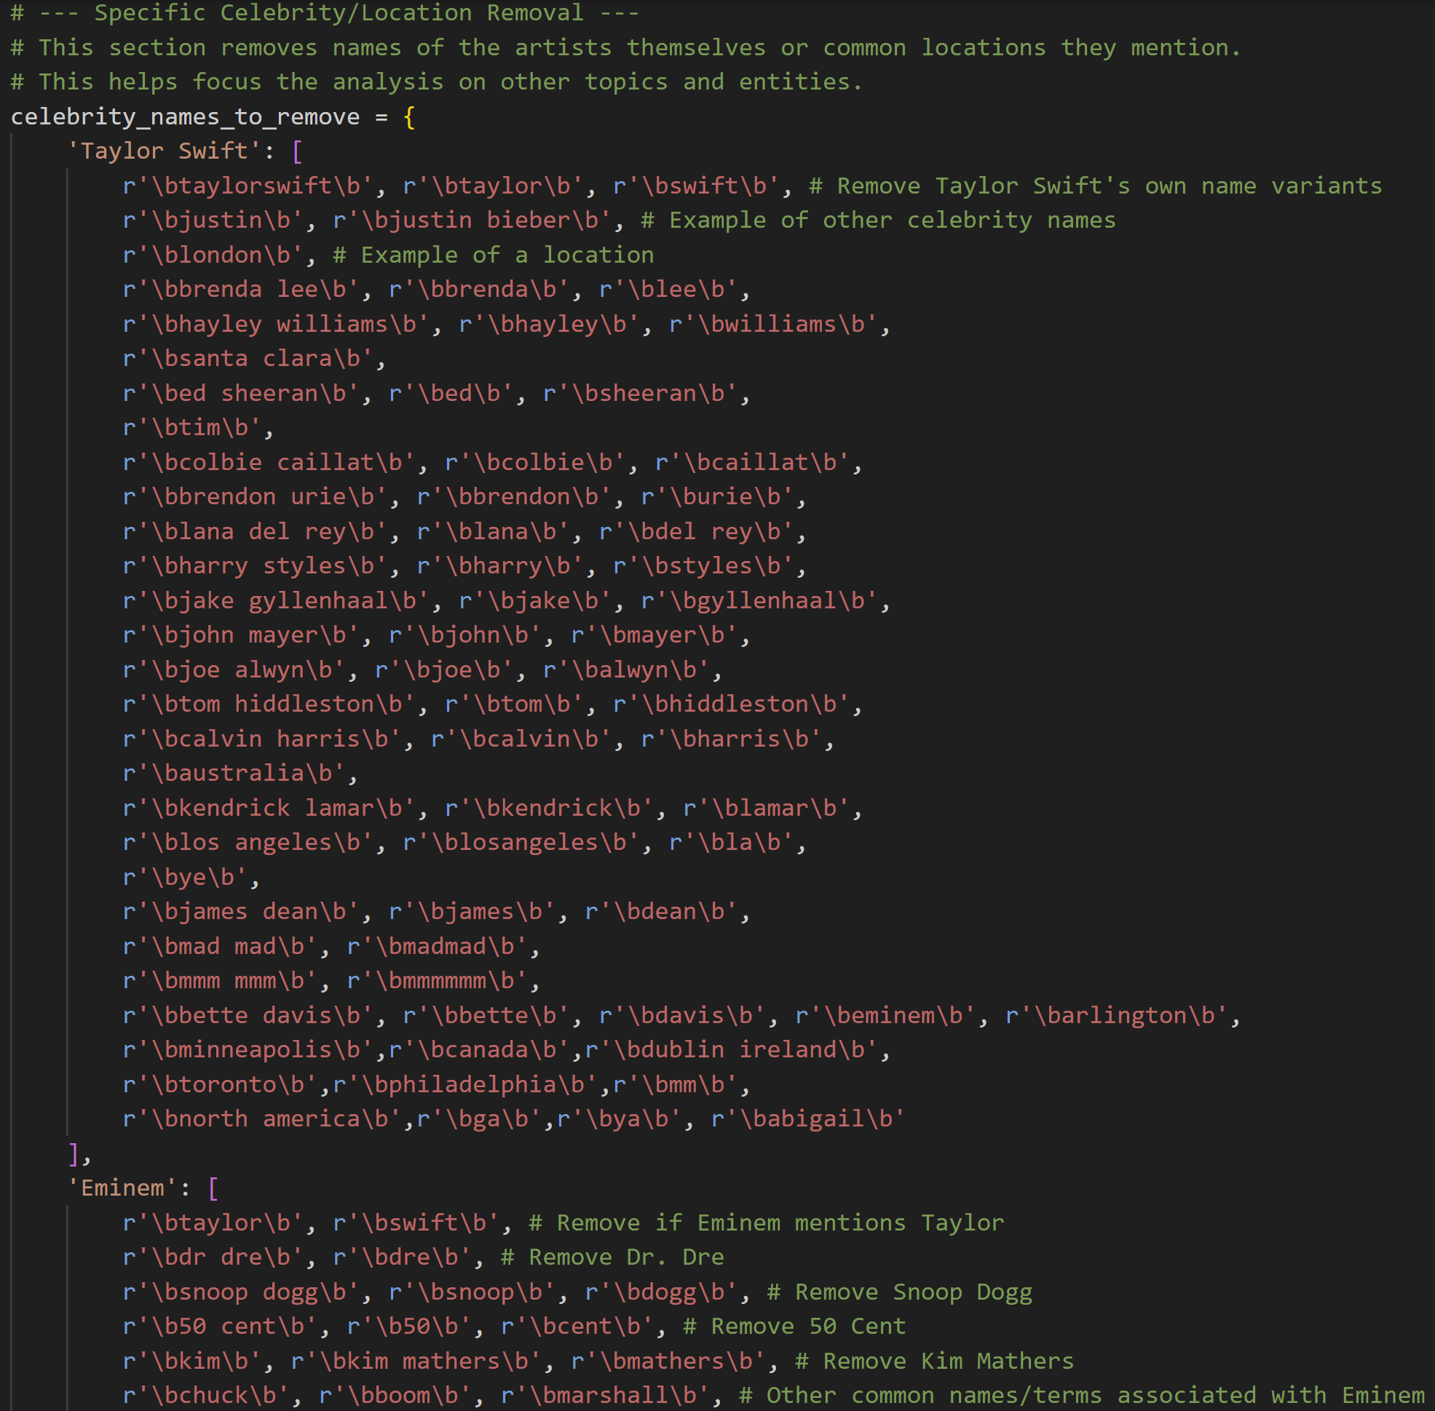
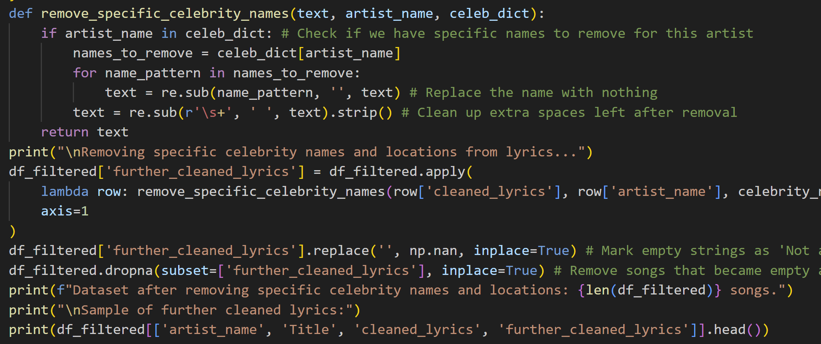
Specific word removal

Slide 8
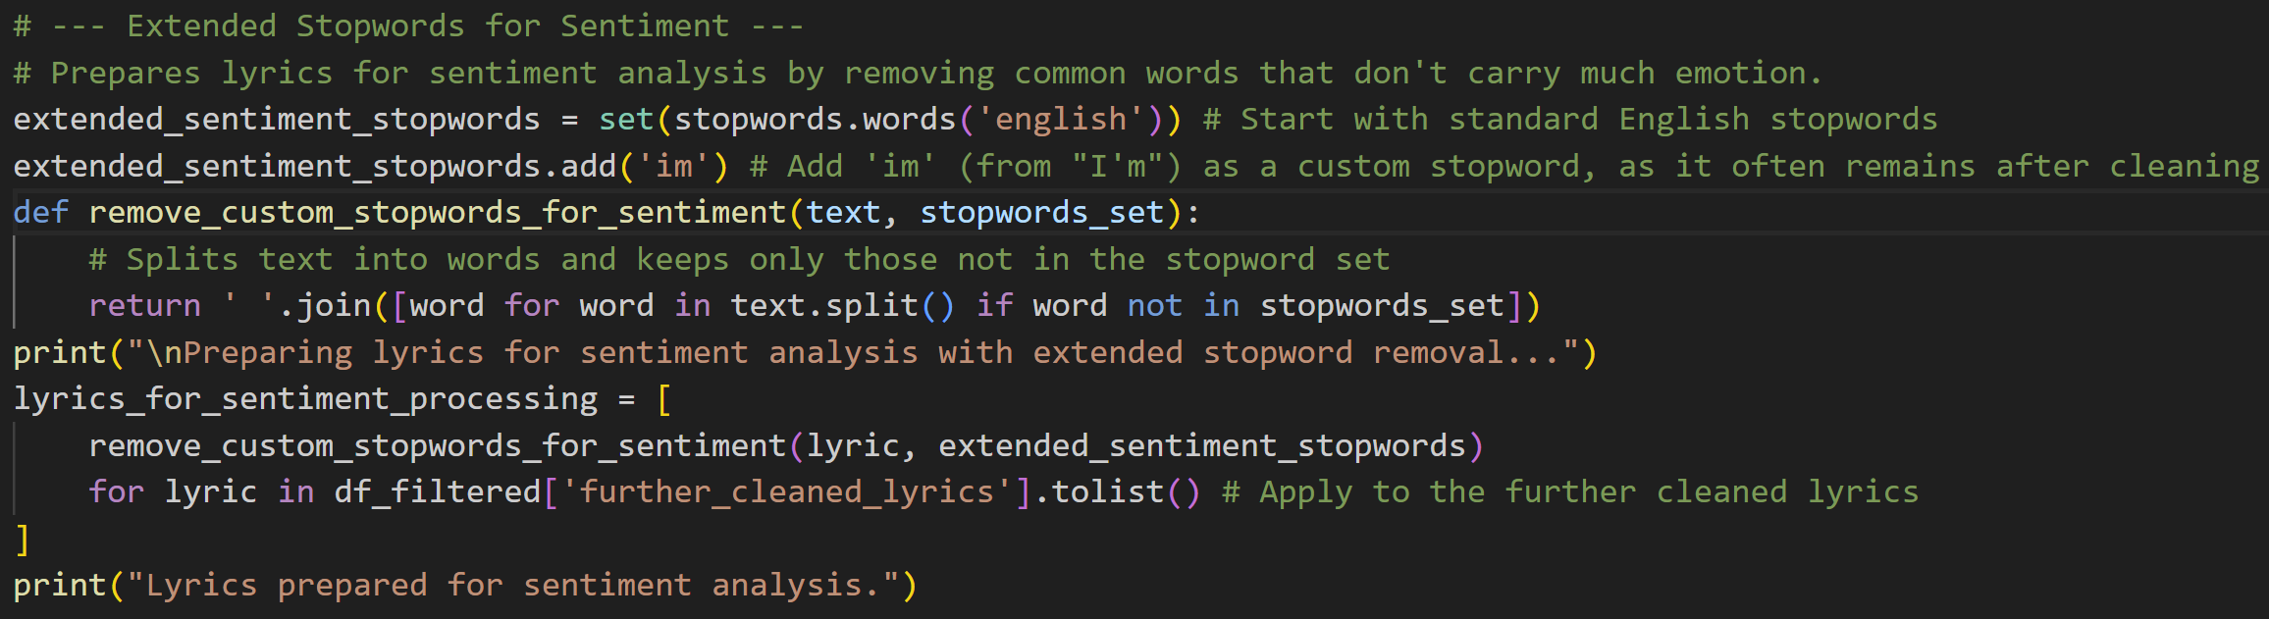
Sentiment Analysis Pre-processing with Extended Stopwords

Slide 9
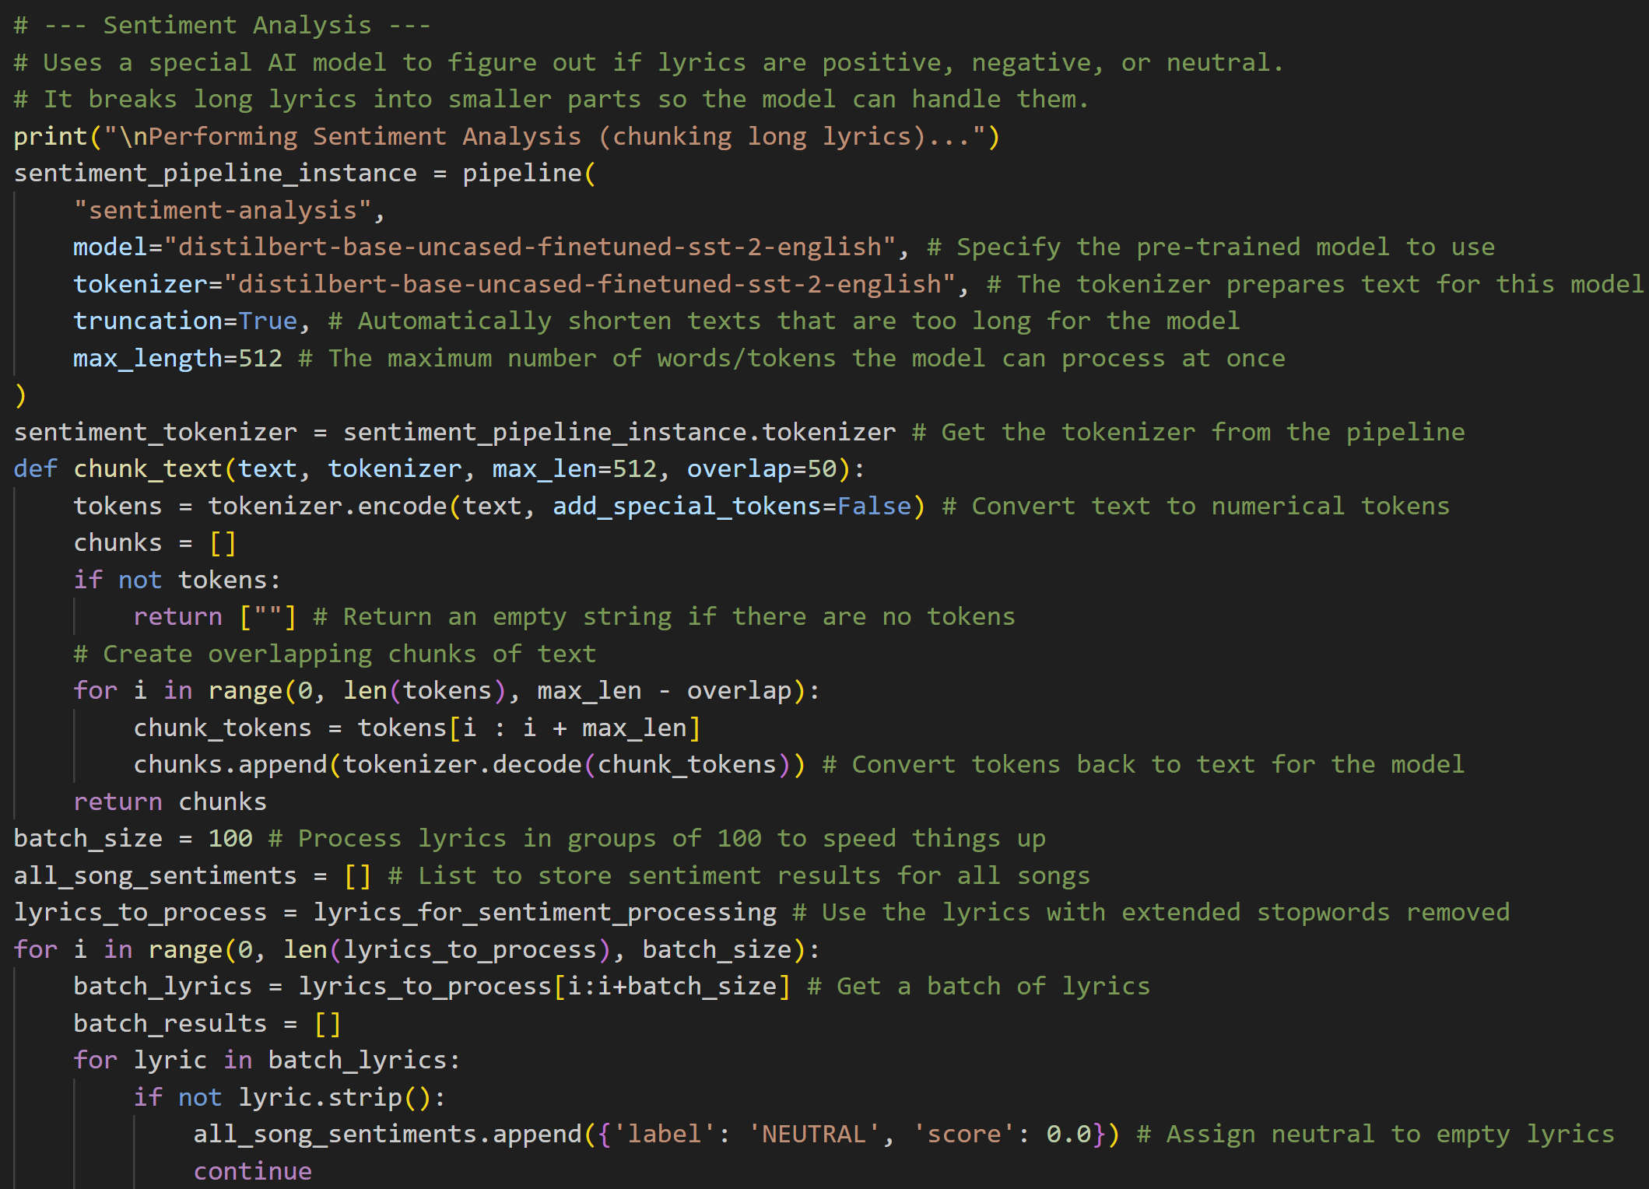
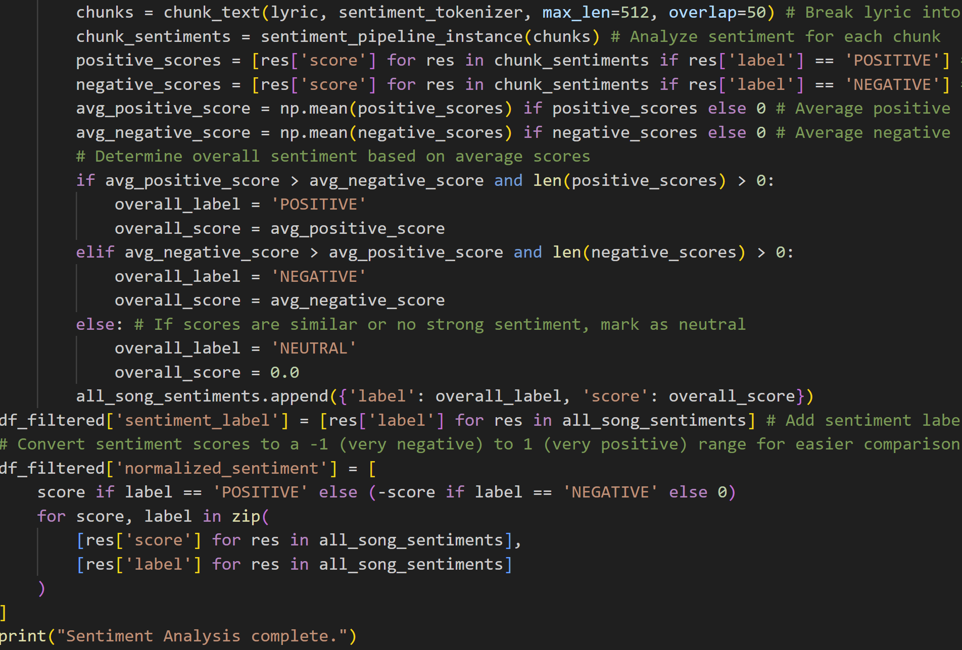
Sentiment Analysis Implementation

Slide 10
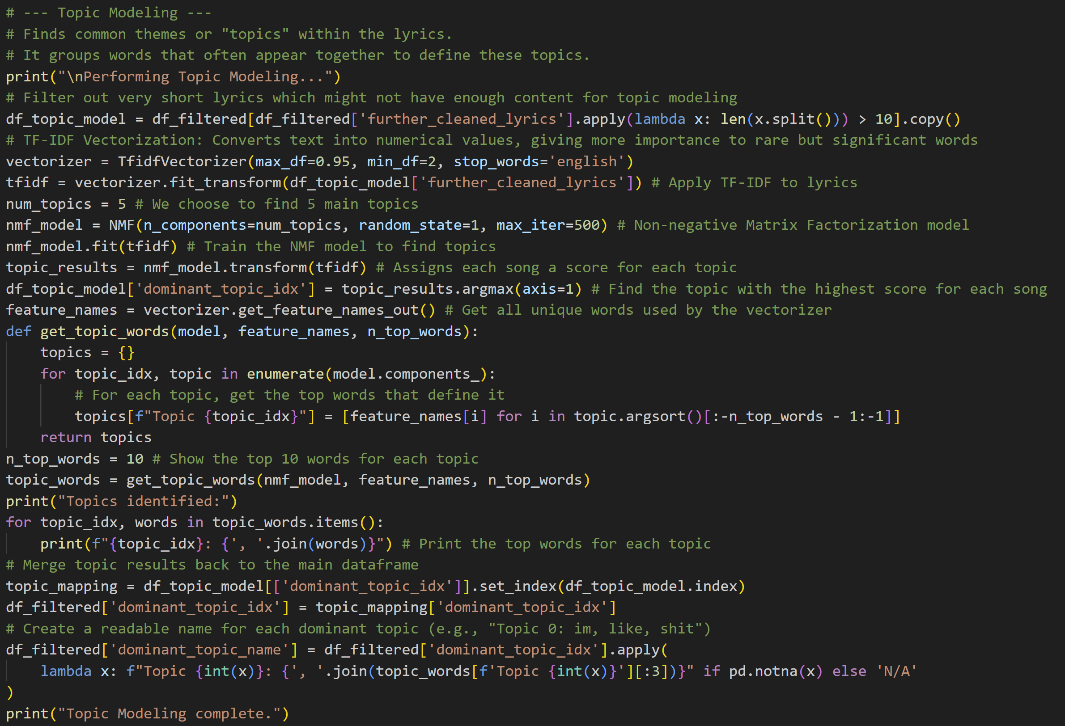
Topic Modeling Implementation

Slide 11
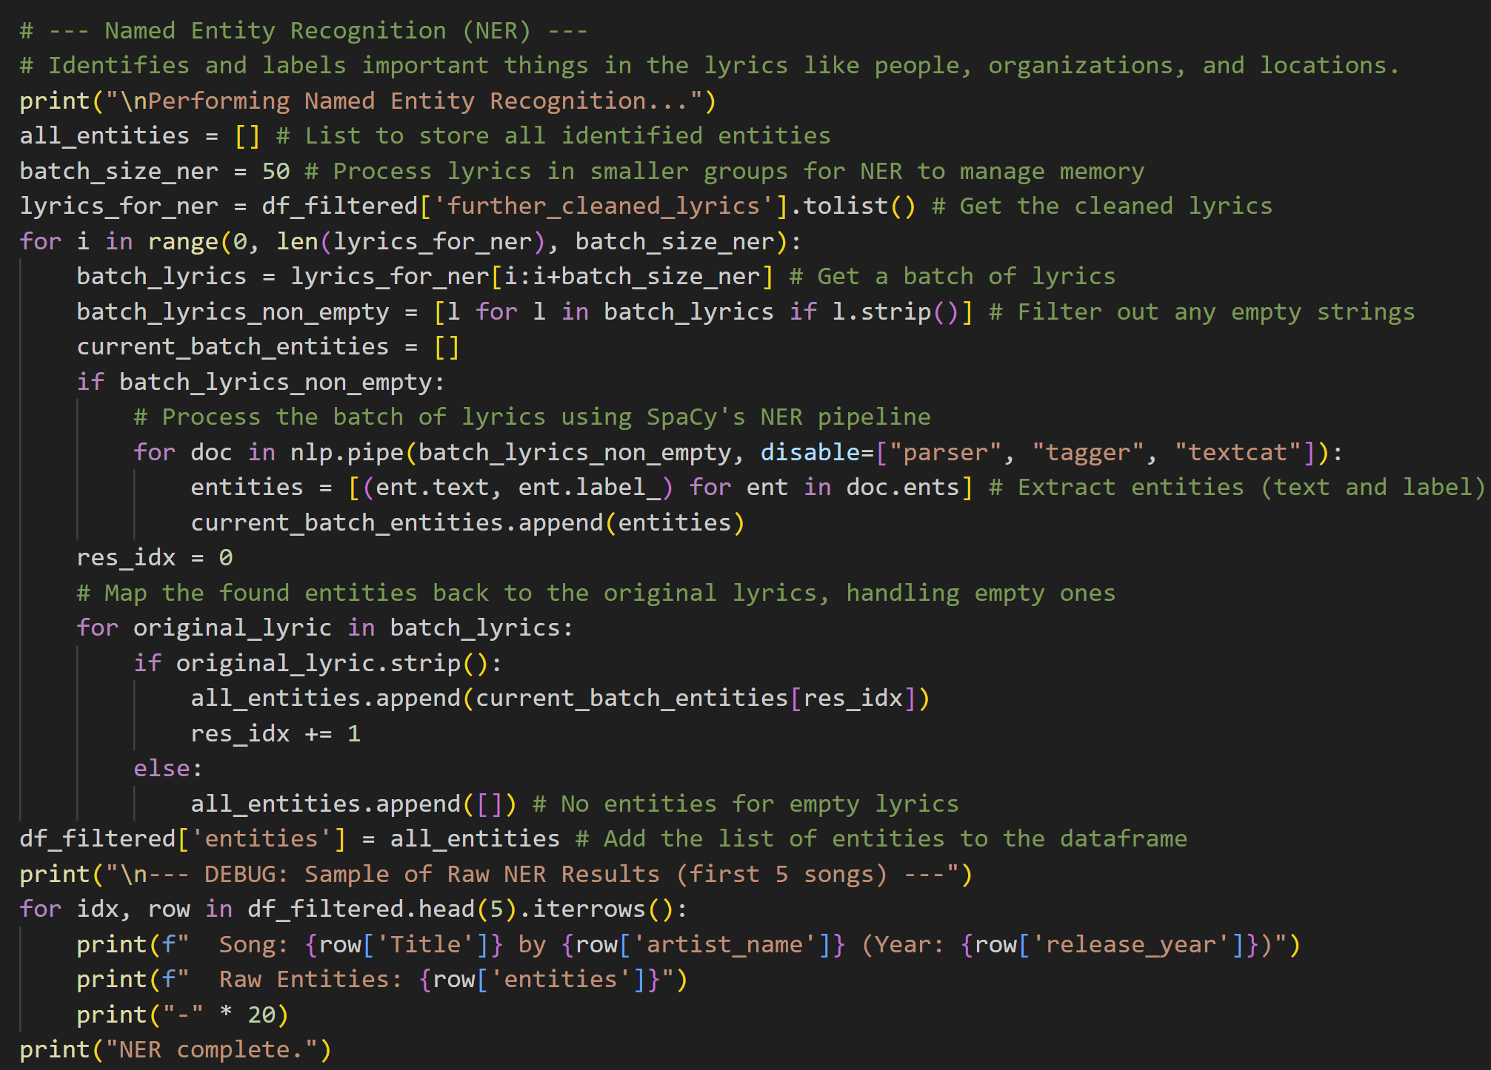
Named Entity Recognition (NER) Implementation

Slide 12
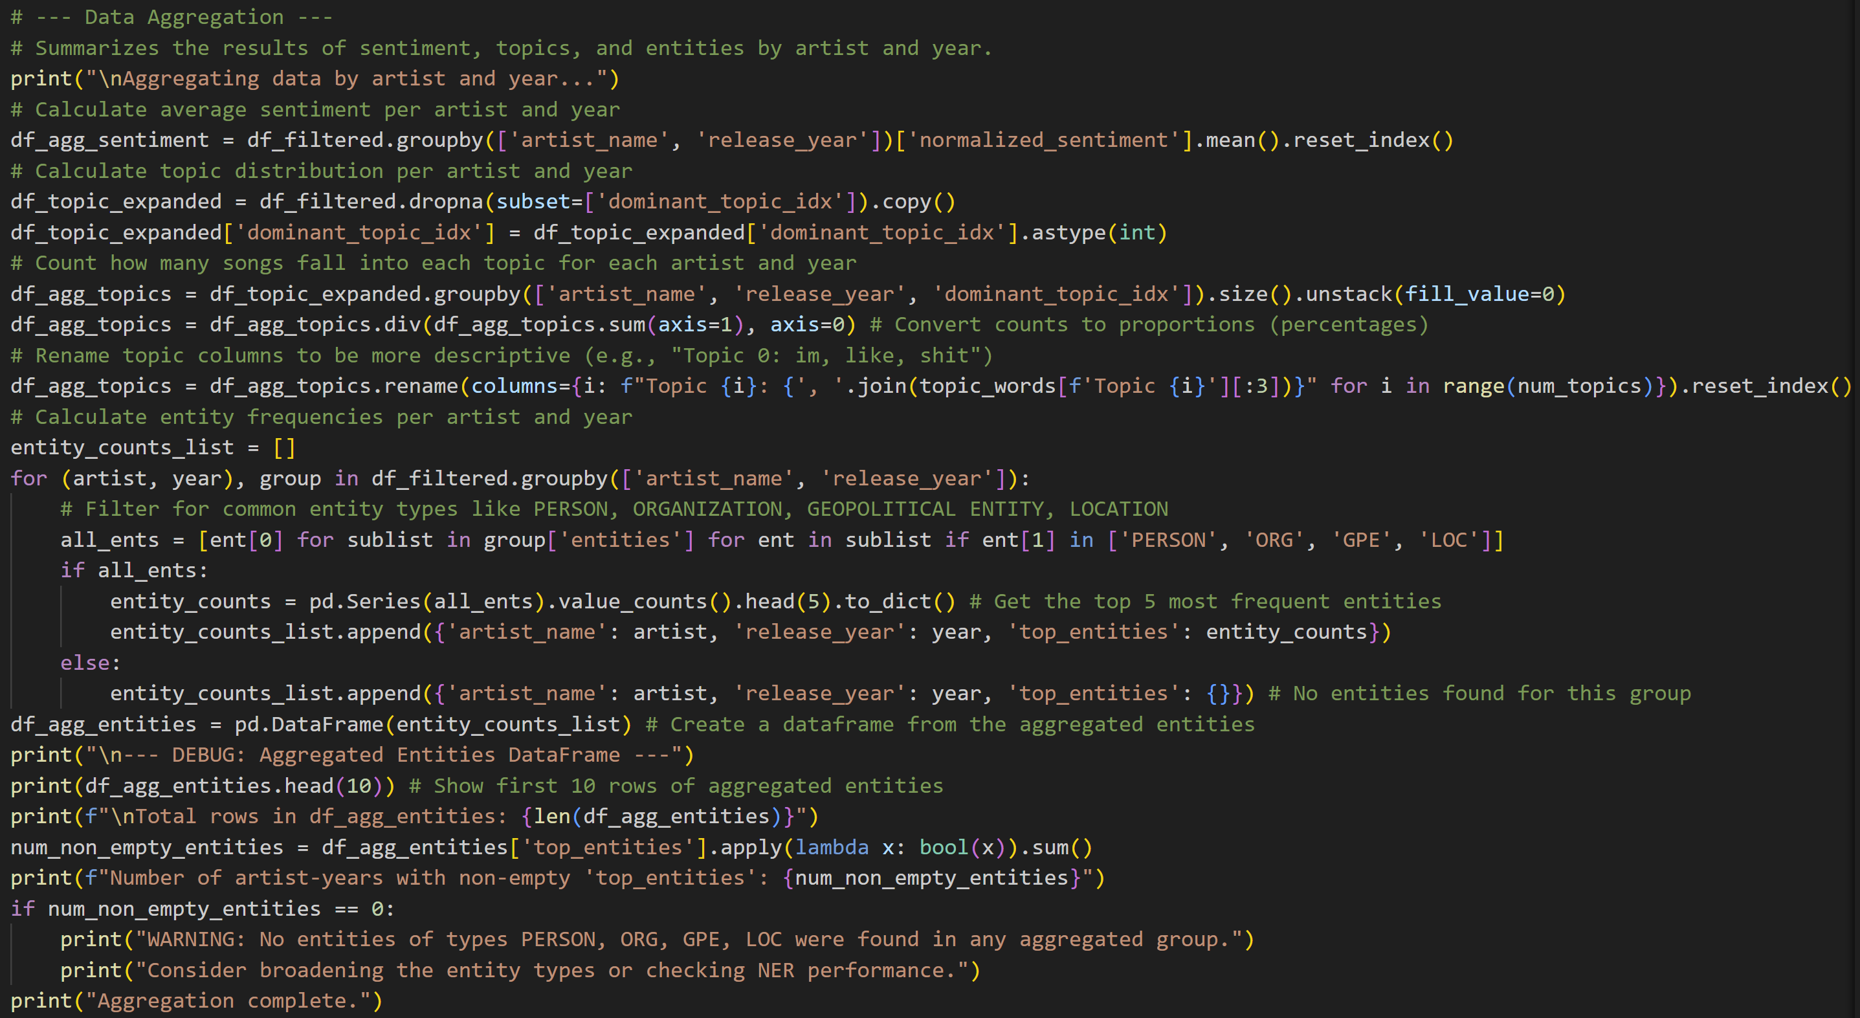
Data Aggregation

Slide 13
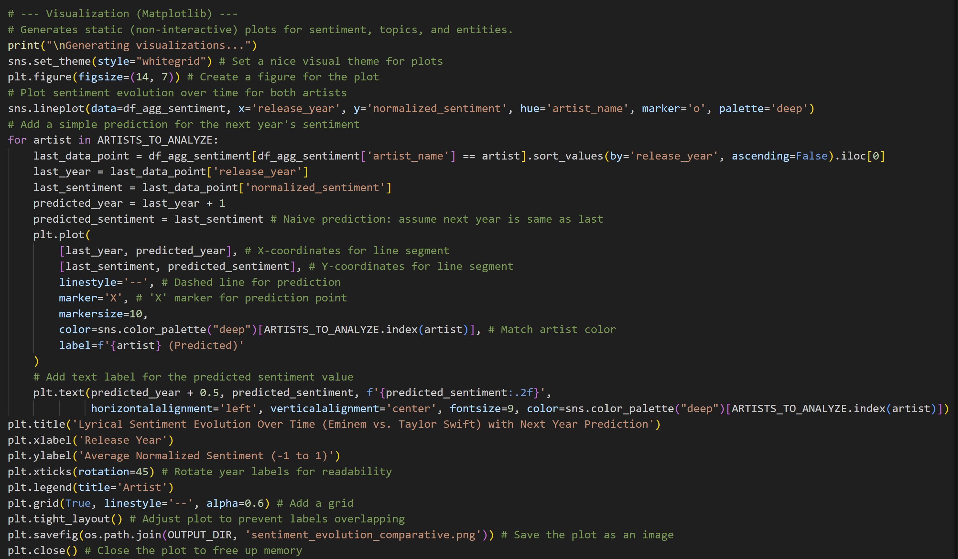
Static Visualizations with Matplotlib/Seaborn

Slide 14
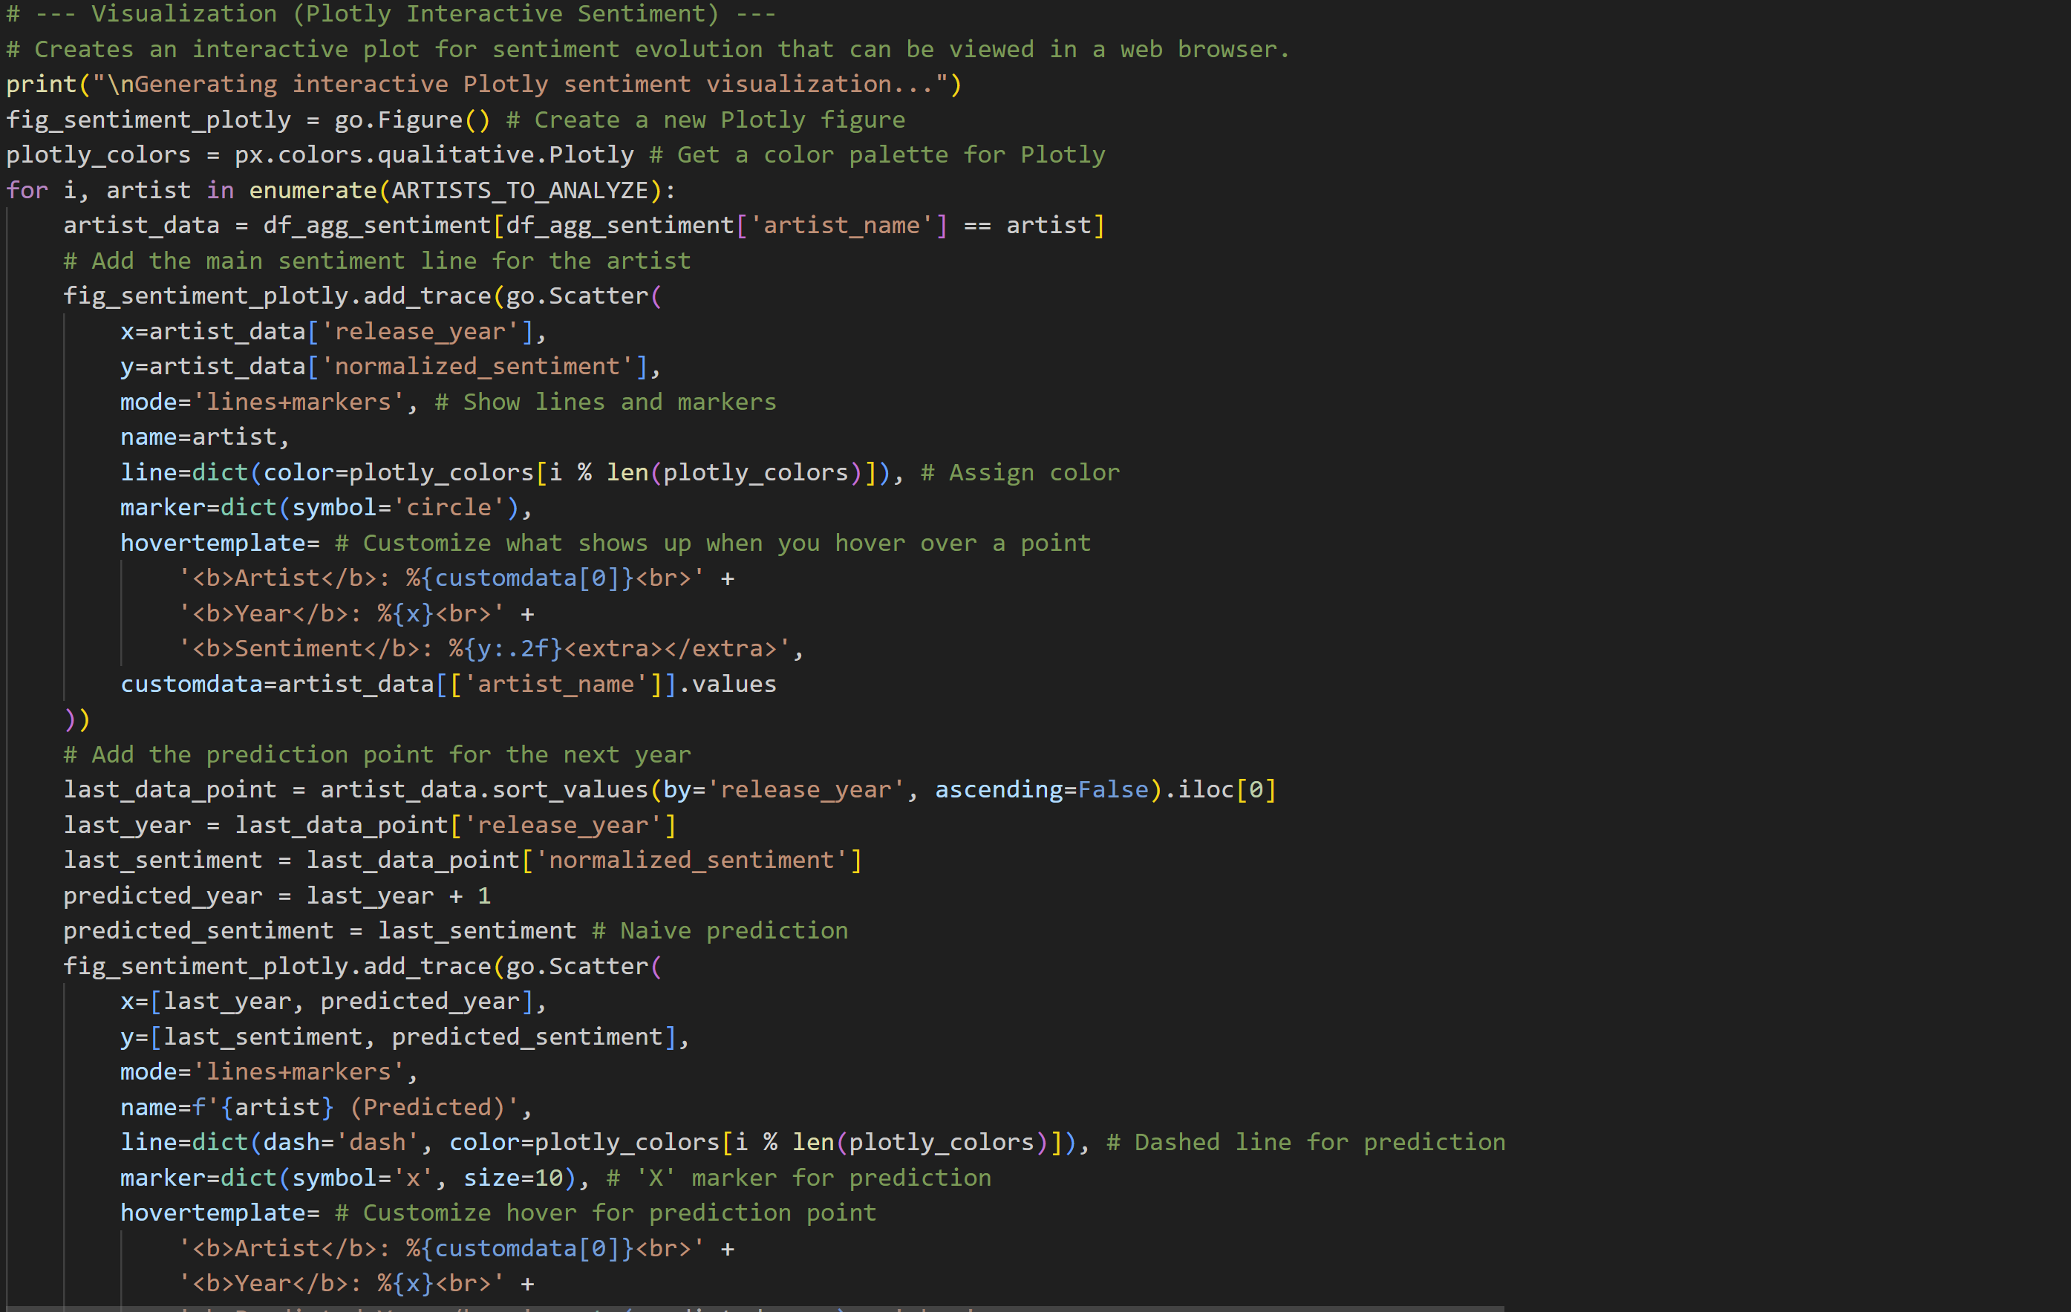
Interactive Sentiment Visualization with Plotly

Slide 15
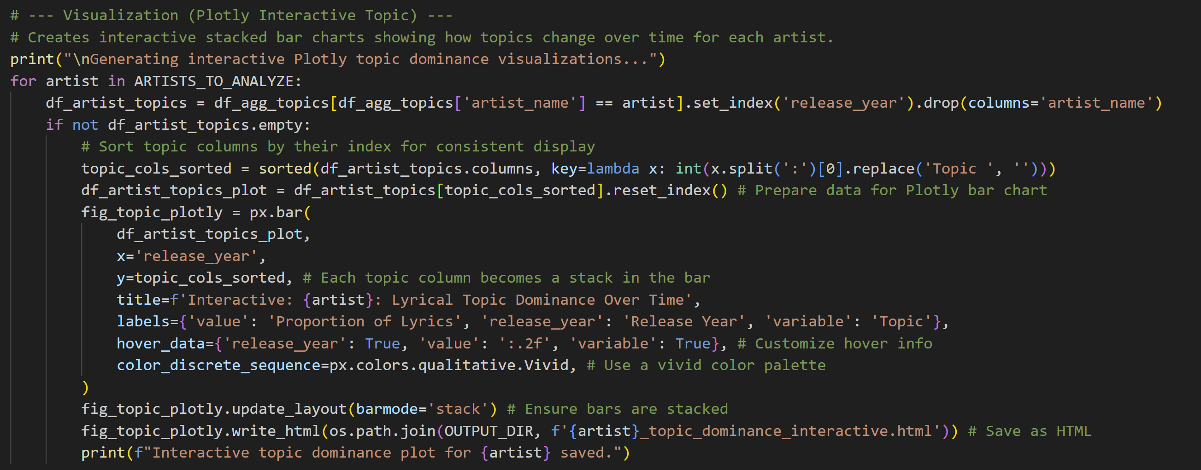
Interactive Topic Dominance Visualization with Plotly

Slide 16
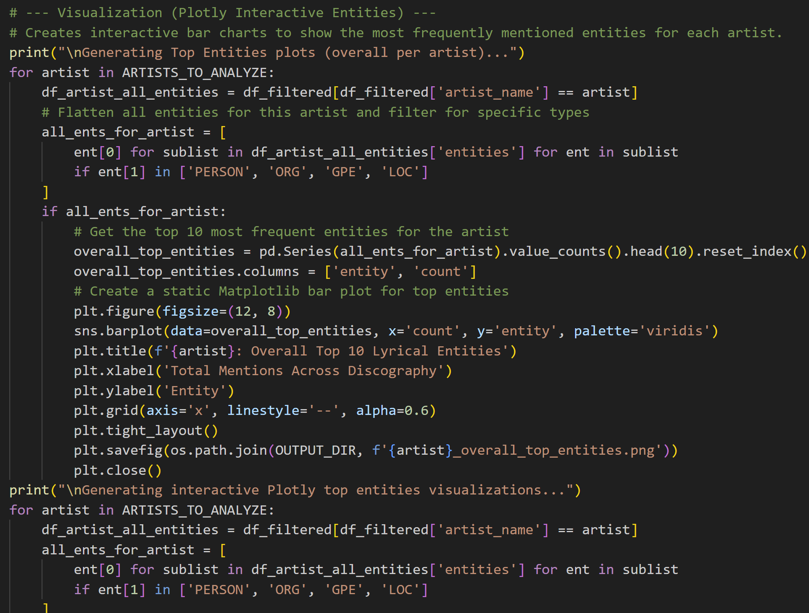
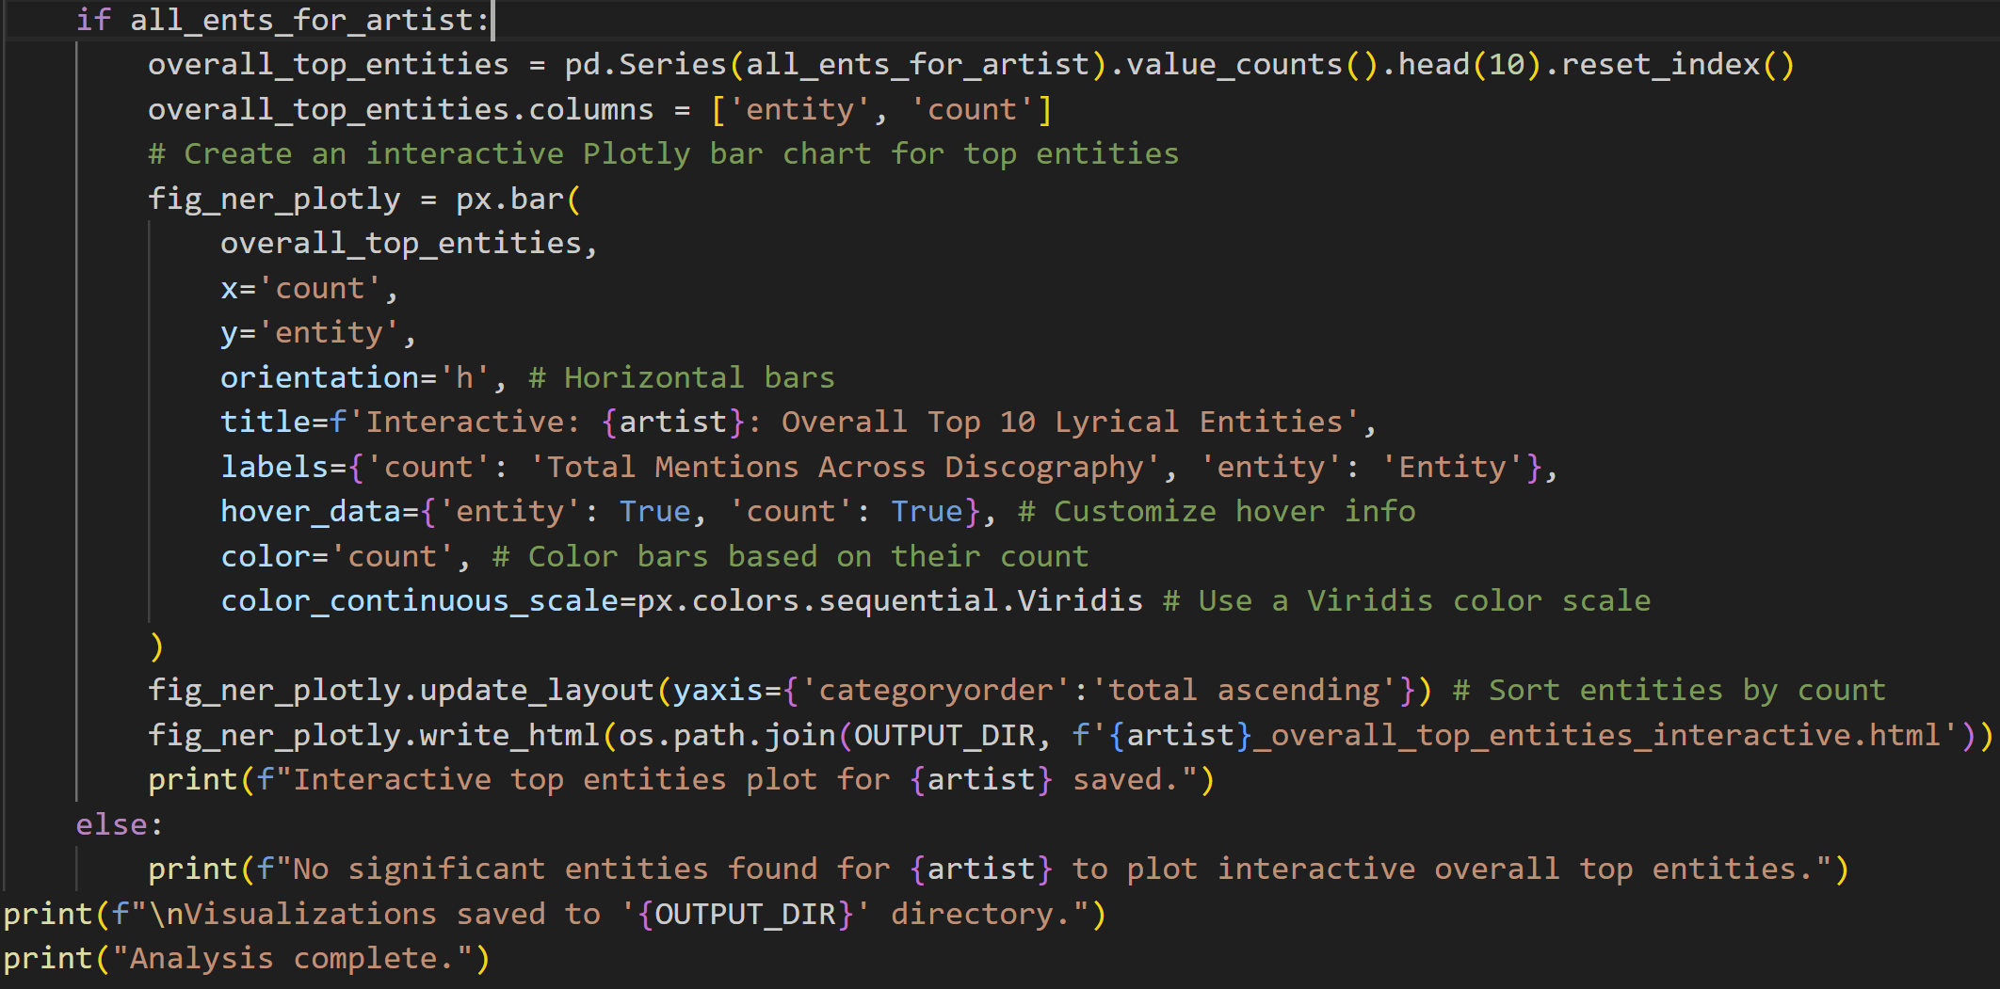
Interactive Entity Visualization with Plotly

Slide 17
Below is streamlit_app.py walkthrough

Slide 18
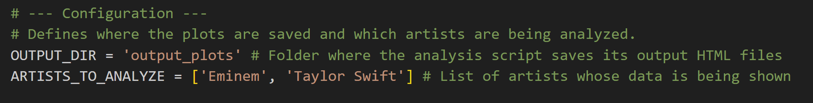
Configuration

Slide 19
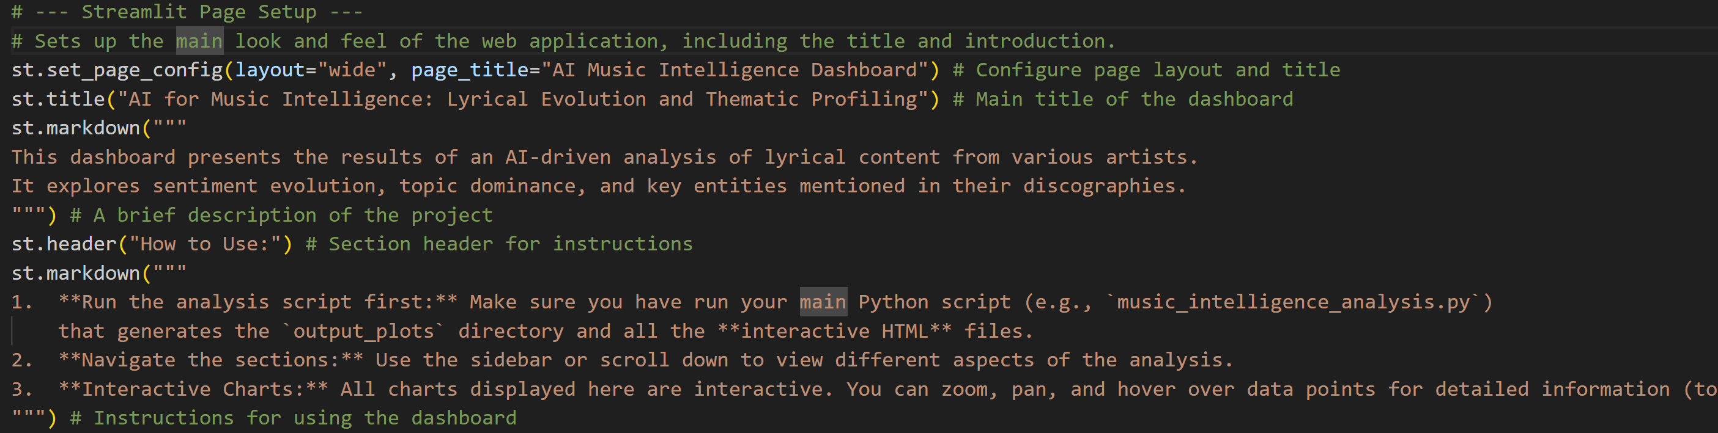
Streamlit Page Setup

Slide 20
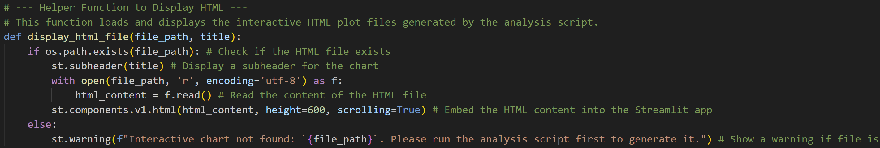
Helper Function to Display HTML

Slide 21

Sidebar Navigation

Slide 22
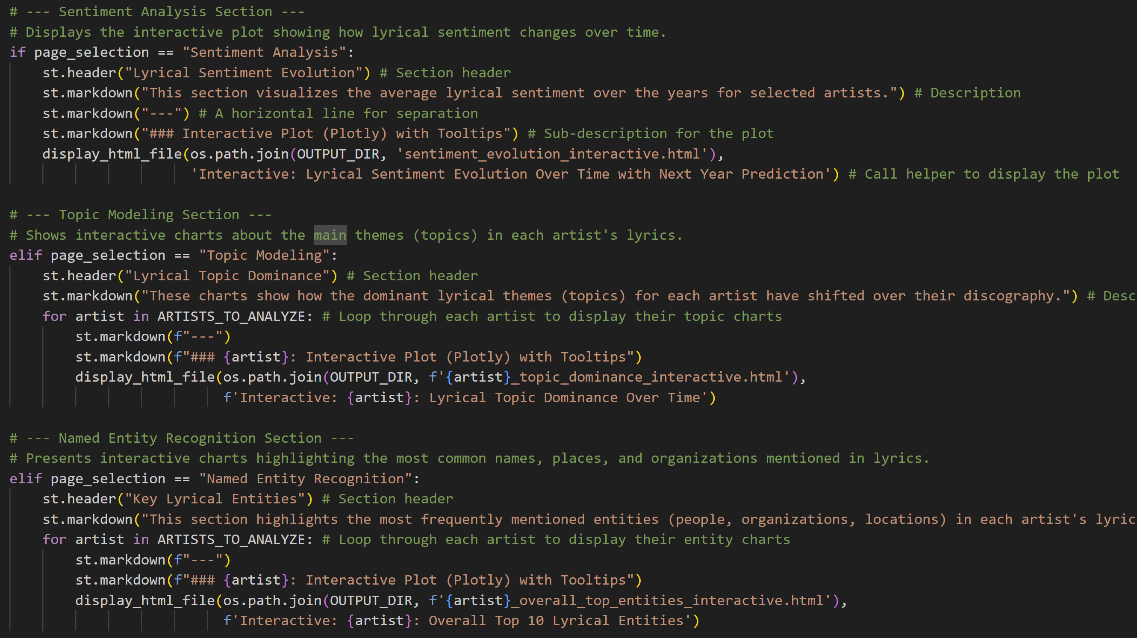
Exploring Lyrical Trends: Sentiment, Topics, and Entities

Slide 23
Future plans to improve
Expand Data Coverage
Use Smarter AI Models
Better Time Analysis
Improve User Experience
More Accurate Predictions
Study Words and Style
Combine with Music Details

Slide 24
Thank you!

